Slide 1

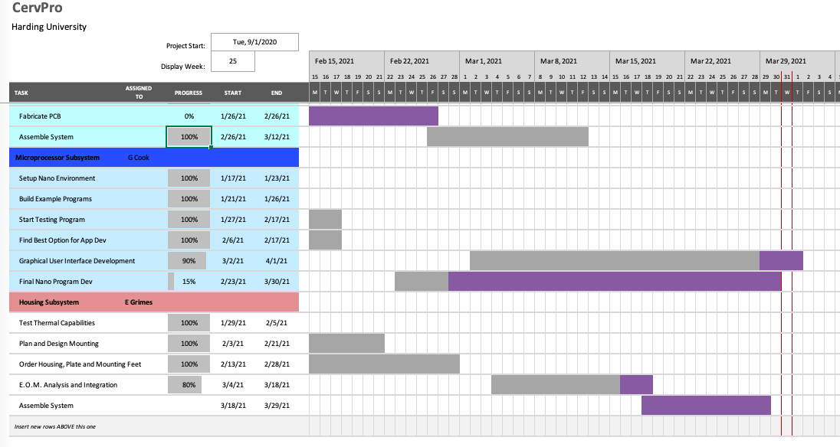

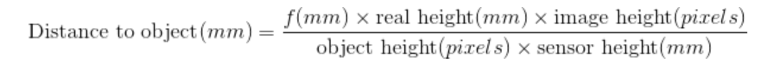
CervPro
Cervical Proprioception Diagnosis: A3 Status
Date: April 1, 2021
Members: Nathan Vielmette, Ethan Grimes, Keneth Chelelgo, and George Cook
Background
PT cervical proprioception (CP) assessments are subjective and determined by PT opinion.
Motivation is to create device that gives PTs objective data that shows patients’ ability to sense head and neck position in space.
Device will sense head position and angular velocity.
Proposed Countermeasures
Remanufacture PCB
Work with the OpenCV team on assessing the camera
Recent Results
LCD touch screen assembled and tested
User interface problem is mostly solved
Calculated focal length of the camera
Converted pixel length to physical length
PT students confirmed for final testing
PCB feet have shipped
Current Conditions
Goals/Targets
Use of device will be faster than double standard CPE test time
Patient will not need to touch any part of device
Accurately measures head position and speed within 5% error margin
Device will be movable and <10lbs
Next Steps
Integrate equations of motion in the program (George and Ethan)
Validate equations of motion (George and Ethan)
Quickly remanufacture PCB (Nathan)
Confirm scheduling of PT students for testing (Keneth)
Analysis
PCB no longer functional
Camera will not talk to edited program

Slide 2
CervPro
Cervical Proprioception Diagnosis: A3 Status
Date: January 21, 2021
Members: Nathan Vielmette, Ethan Grimes, Keneth Chelelgo, and George Cook

